Slide 1
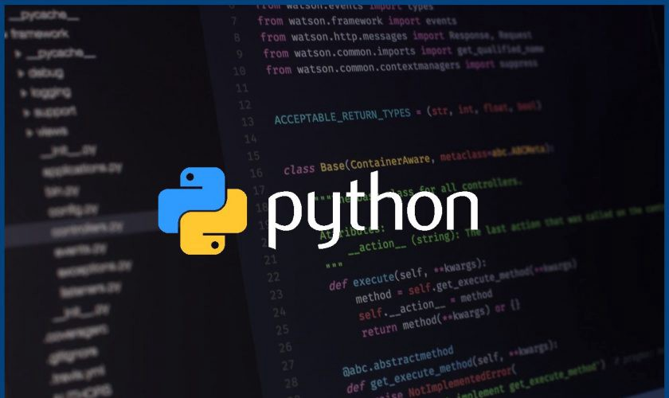
Introduction to Python Programming

Slide 2
Agenda
What is Python
Why do people use Python
Syntax
Python Data Types
Control Statements
Function and Classes
Flask framework for Web Applications

Slide 3
What is Python … ?
Python is a general purpose programming language that is often applied in scripting roles.
Python is an Interpreted language
Multi-purpose (Web, GUI, scripting, etc.)
Strongly typed and dynamically typed
Focus on readability and productivity

Slide 4
Why do people use Python
Python can be used on a server to create web applications
Alongside with software to create workflows
Read/write files and database connection
Handle big data and perform complex mathematics
Widely used in AI & Data Science projects
Rapid prototyping, or for production-ready software development
Simple syntax similar to English language

Slide 5
Releases
Created in 1989 by Guido Van Rossum (Netherlands)
Python 1.0 released in 1994
Python 2.0 released in 2000
Python 3.9 released in 2008
Python 2.7 is the recommended version
Python 3.0 adoption will take a few years

Slide 6

Syntax

Slide 7
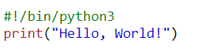
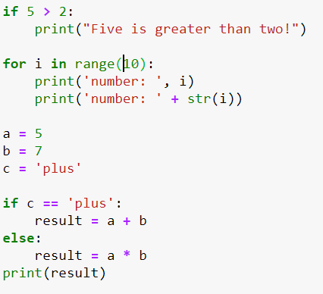
Python example
Identation
Condition statements
Math operations

Slide 8
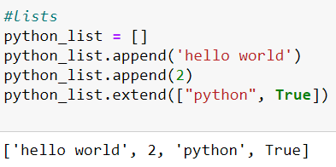
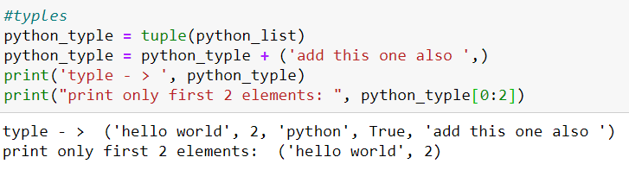
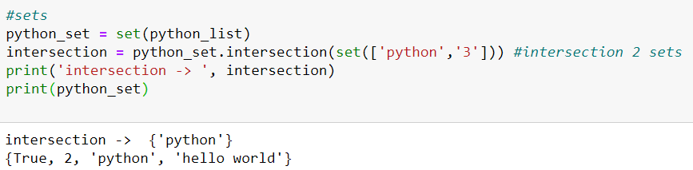
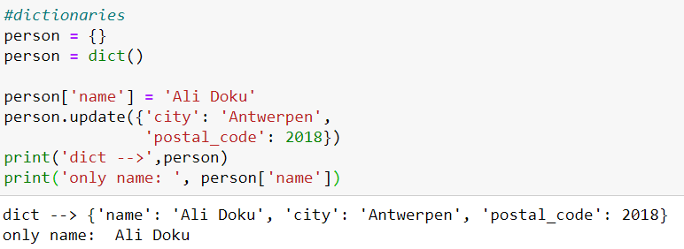
Data types

Slide 9
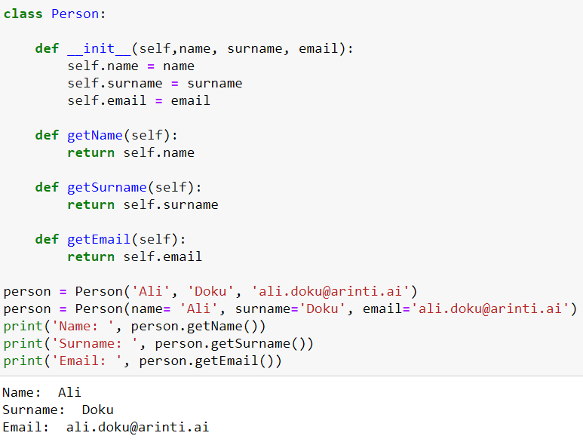
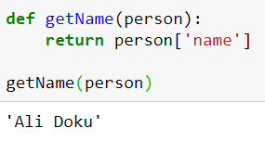
Functions & classes
A function is a block of code which accepts data & parameters and return data as a result.
Python is an object oriented programming language
Everything in Python is an object with its properties and methods

Slide 10
Functions & classes
Contructor
A function is a block of code which accepts data & parameters and return data as a result.
Python is an object oriented programming language
Everything in Python is an object with its properties and methods
Function

Slide 11
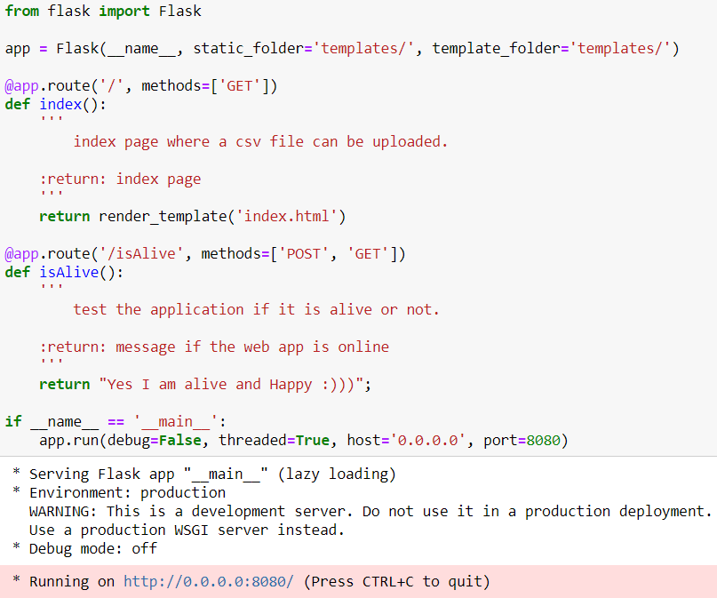
Flask Micro-Framework
Import library
Initialize Flask object
routing
Serving web app on localhost port 8080

Slide 12
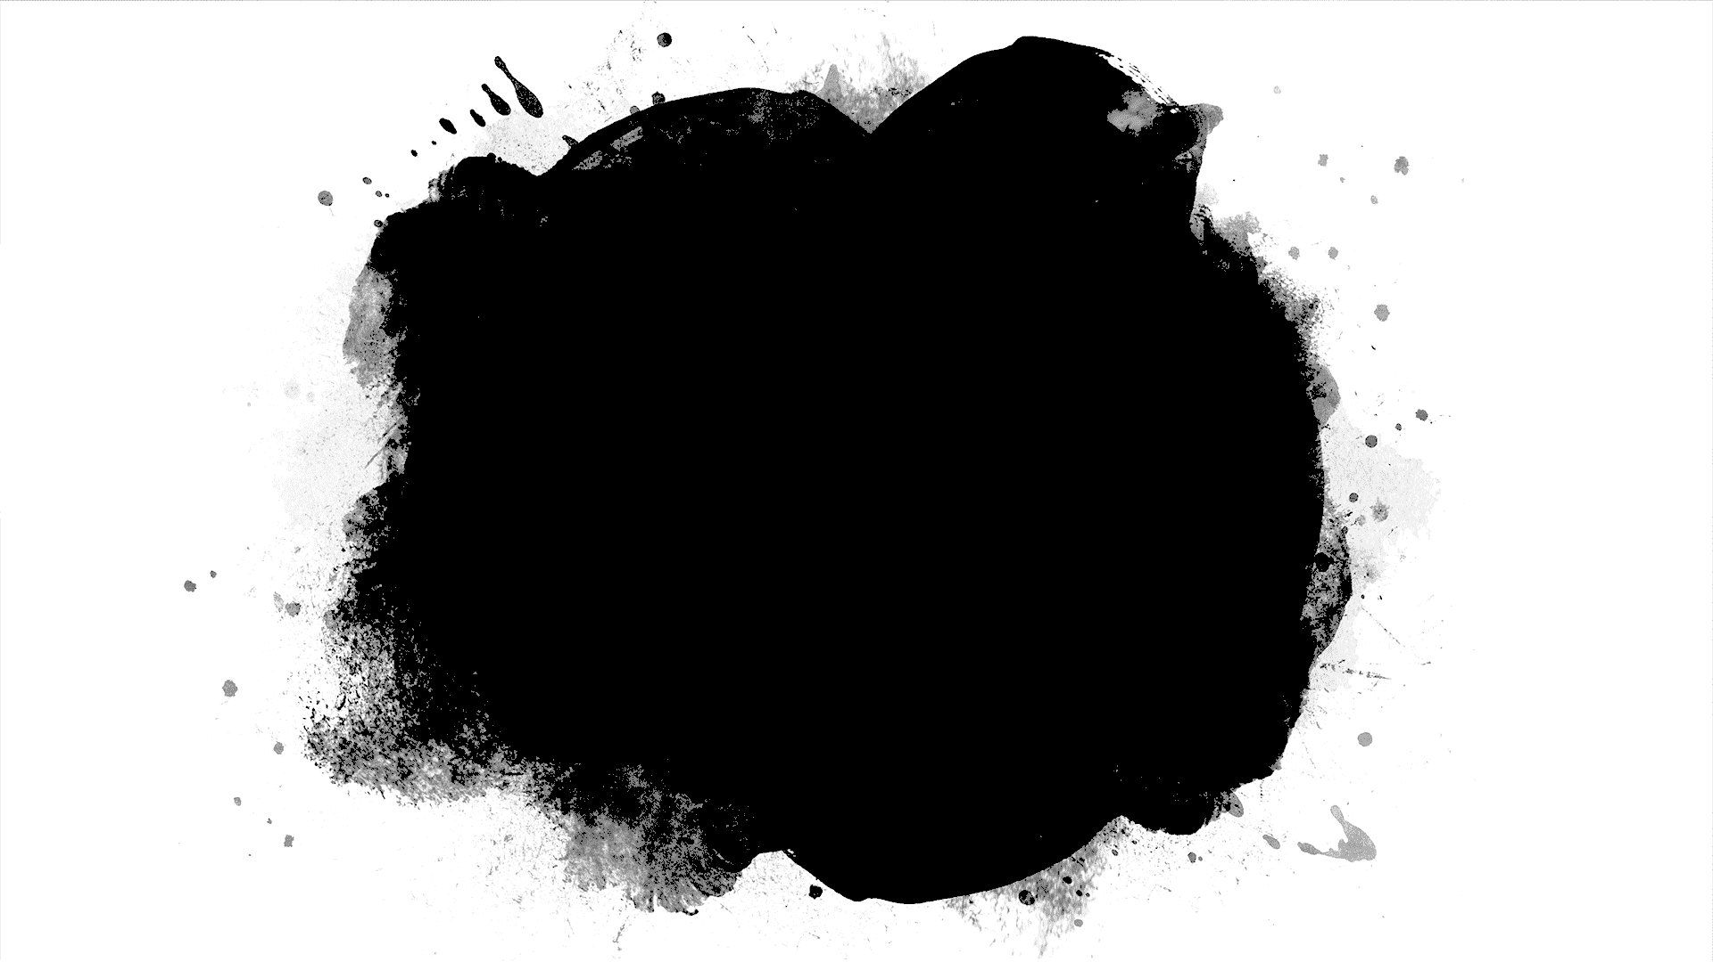
Let’s start Coding

Slide 13
Ali Doku AI Engineer & Data Scientist +32 489 84 28 73 ali.doku@arinti.ai
www.arinti.ai
Stationstraat 55 2800 Mechelen

